Slide 1
CZ3005 Artificial Intelligence Game Theory
Asst/P Hanwang Zhang
https://personal.ntu.edu.sg/hanwangzhang/
Email: hanwangzhang@ntu.edu.sg
Office: N4-02c-87

Slide 2
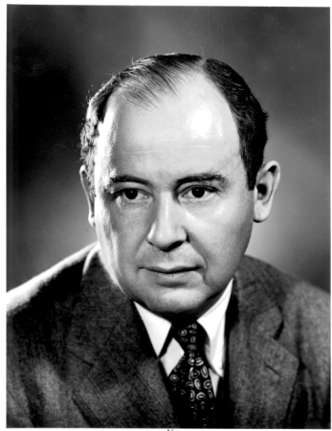
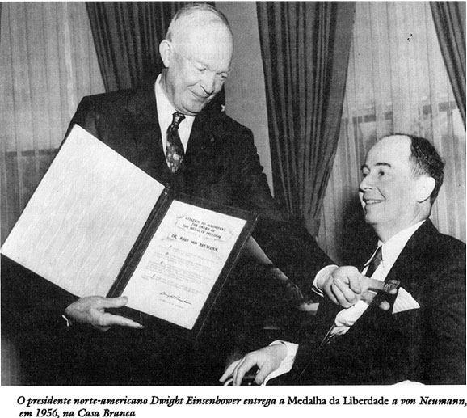
What is Game Theory?
Game theory studies settings where multiple parties (agents) each have
different preferences (utility functions),
different actions that they can take
Each agent’s utility (potentially) depends on all agents’ actions
What is optimal for one agent depends on what other agents do
Very circular!
Game theory studies how agents can rationally form beliefs over what other agents will do, and (hence) how agents should act
Useful for acting as well as predicting behavior of others
John von Neumann
Notes:
Different utility function: If you are carry your utility is how much gold you earn, if you are support, your utility is how vision control, how telescope, how many wild creatures stacks.
Actions: different heroes have different skills.
Do you think adv search is a subset of game theory, or vice versa?

Slide 3
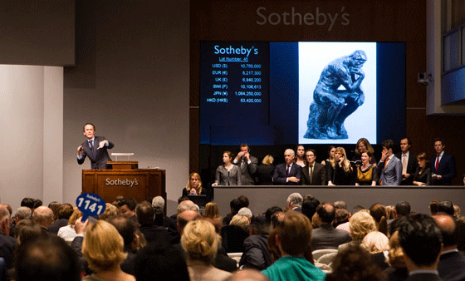
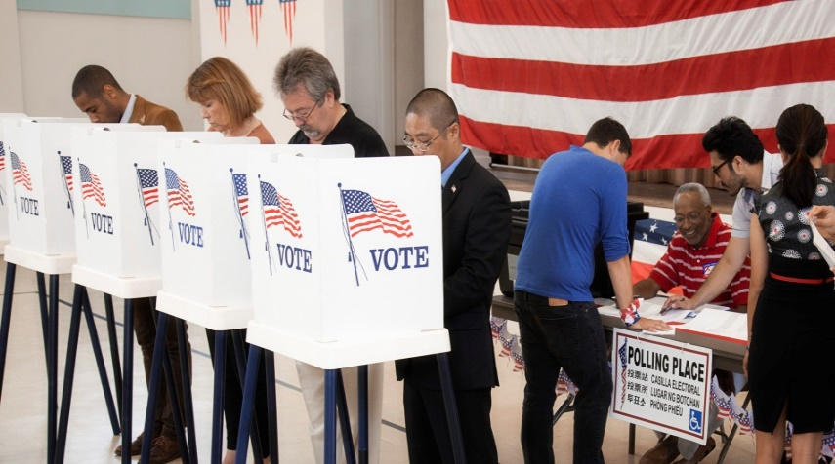
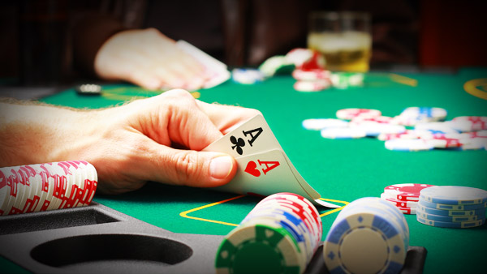
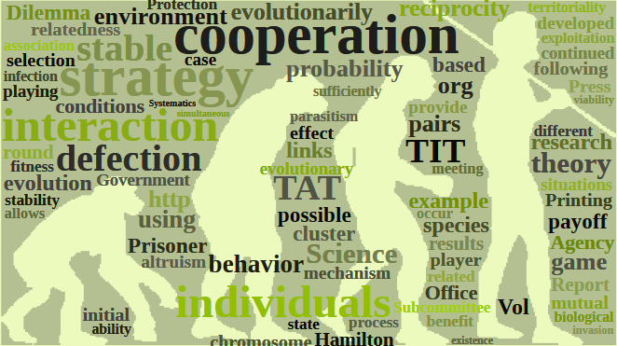
What is Game Theory?
Economics
Politics
Games
Biology

Slide 4
Normal Form Games – An Example
List of players, strategies, payoffs
Simultaneous or not
Zero-sum here but not necessary
Analysis:
What should they do?
Advice to player A
Player B
Rock
0, 0 | 1,-1 | -1,1
-1, 1 | 0, 0 | 1, -1
1, -1 | -1, 1 | 0, 0
Player A
Rock
Notes:
We will use only a simple example. You can consider this as a game matrix instead of a game tree in adversarial example. What’s the key difference between tic-tac toe, and this game? Present at the same time.

Slide 5
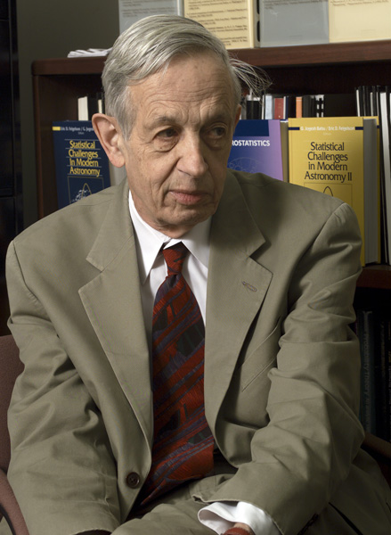
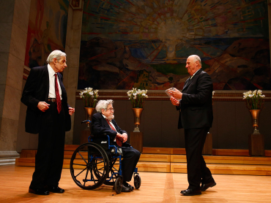
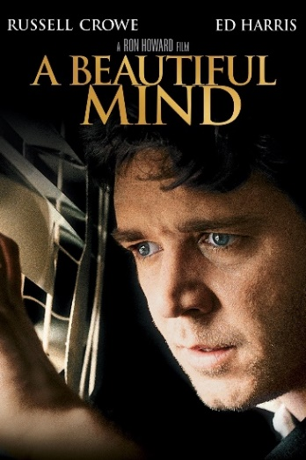
Nash Equilibrium
Each agent is selfish
Each agent makes decision based on what he thinks others would do
No one can do better by changing strategy solely
Any game with finite actions must have a Nash Equilibrium.
Notes:
In adv search, each agent is also selfish.

Slide 6
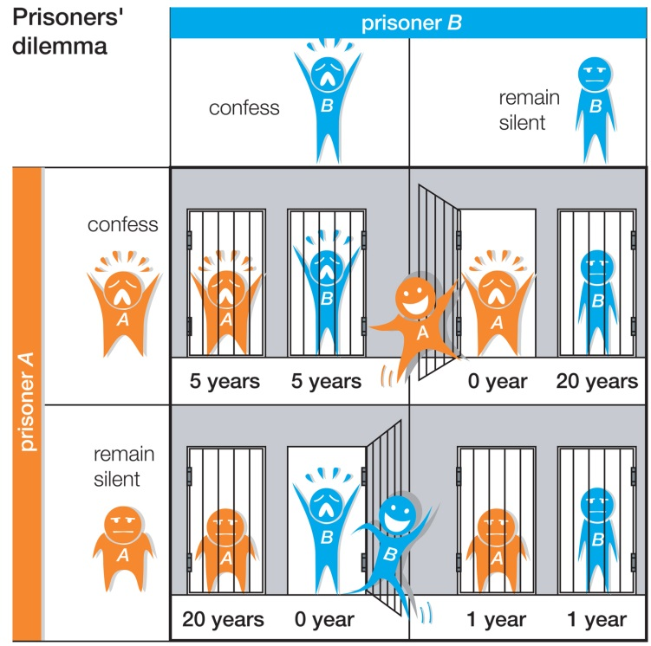
Nash Equilibrium
Notes:
Neijuan.

Slide 7
Game Abstraction
Confess
Silent
5,5
0,20
Confess
20,0
1,1
Silent

Slide 8
Let’s look at Red when Blue “confess”
Confess
5,5
Confess
20,0
Silent
Notes:
confess

Slide 9
Let’s look at Red when Blue “Silent”
Silent
0,20
Confess
1,1
Silent
Notes:
Confess always leads to better result.

Slide 10
Let’s look at Red: Silent dominates Confess
Confess
Silent
5,5
0,20
Confess
20,0
1,1
Silent
Notes:
What does dominates mean? Given varying blue’s action, we’ve found the red’s stragy.

Slide 11
Let’s look at Blue when Red “confess”
Confess
Silent
5,5
0,20
Confess

Slide 12
Let’s look at Blue when Red “silent”
Confess
Silent
20,0
1,1
Silent
Notes:
A rational player never chooses the dominating strategy: silent. So, he will choose confess.

Slide 13
Nash Equilibrium: both confess
Confess
Silent
5,5
0,20
Confess
20,0
1,1
Silent
Cooperation would be better for both! But, rational for both to defect!
Notes:
No one want to escape from this stable point. This is equilibrium.

Slide 14
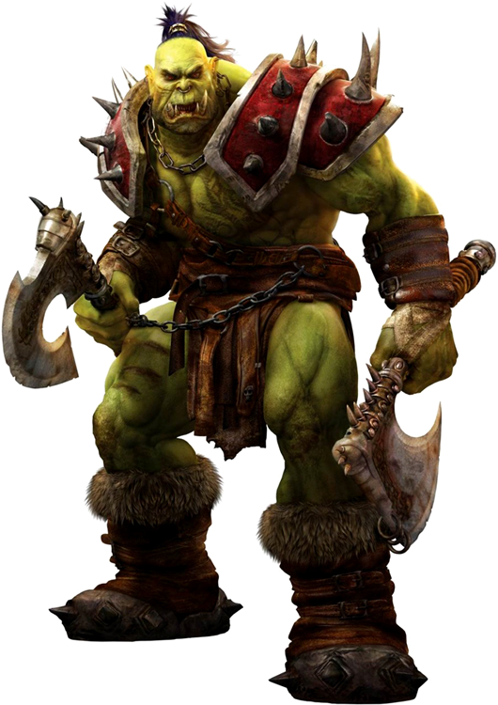
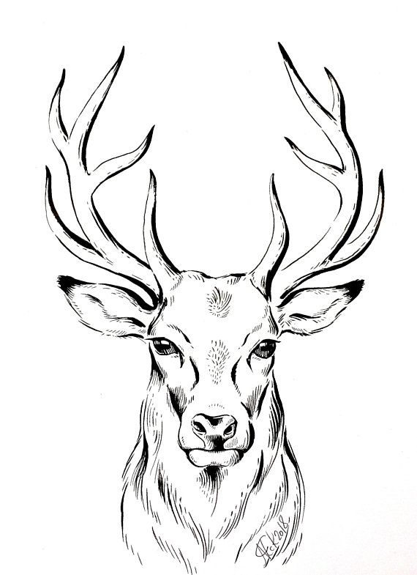
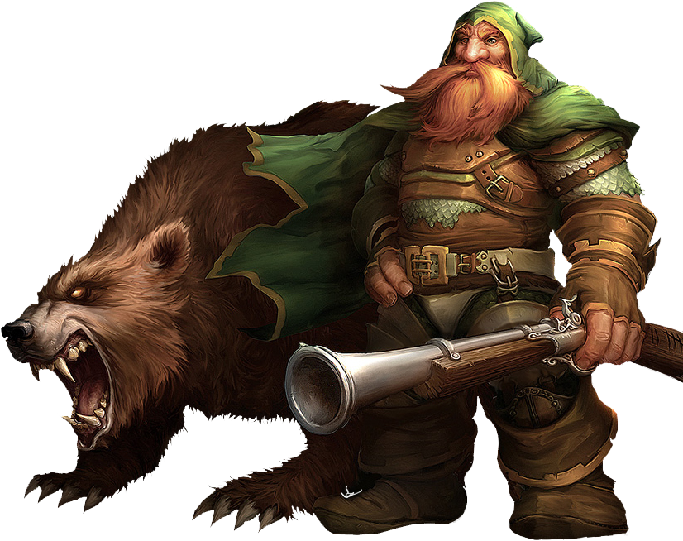
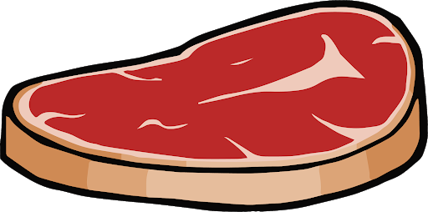
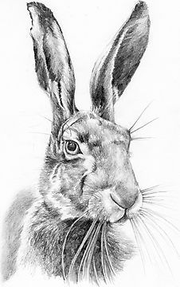
Nash Equilibrium

Slide 15
Game Abstraction
Stag
Hare
3,3
0,2
Stag
2,0
1,1
Hare

Slide 16
Let’s look at Red when Blue “Stag”
Stag
3,3
Stag
2,0
Hare

Slide 17
Let’s look at Red when Blue “Hare”
Hare
0,2
Stag
1,1
Hare

Slide 18
Let’s look at Red: Two Strategies
Stag
Hare
3,3
0,2
Stag
2,0
1,1
Hare
Notes:
3→3000, collapse the set to one point.

Slide 19
Let’s look at Blue when Red “Stag”
Stag
Hare
3,3
0,2
Stag

Slide 20
Let’s look at Blue when Red “Hare”
Stag
Hare
2,0
1,1
Hare

Slide 21
Let’s look at Blue: Two Strategies
Stag
Hare
3,3
0,2
Stag
2,0
1,1
Hare

Slide 22
Nash Equilibrium: A Strategy Set
Stag
Hare
3,3
0,2
Stag
2,0
1,1
Hare

Slide 23
Nash Equilibrium: Pure Strategy (Set)
Confess
Silent
Stag
Hare
5,5
0,20
3,3
0,2
Confess
Stag
20,0
1,1
2,0
1,1
Silent
Hare

Slide 24
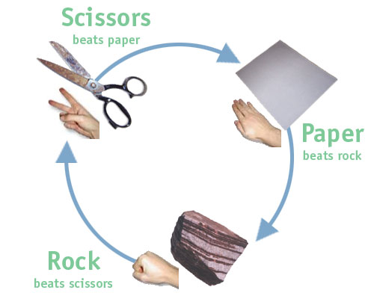
Nash Equilibrium: Mixed Strategy (Set)
Player B
Paper
1/3
Rock
1/3
Scissors
1/3
Paper
0, 0 | 1,-1 | -1,1
-1, 1 | 0, 0 | 1, -1
1, -1 | -1, 1 | 0, 0
1/3
Player A
Rock
1/3
Scissors
1/3
Notes:
Usually happen in real-time game. But not in turn based.
A mixed strategy Nash equilibrium. involves at least one player playing a randomized strategy and no player being able to increase his or her expected payoff by playing an alternate strategy.

Slide 25
Look at Red when Blue “Paper”
Paper
Rock
Scissors
Paper
0, 0 | 1,-1 | -1,1
-1, 1 | 0, 0 | 1, -1
1, -1 | -1, 1 | 0, 0
Rock
Scissors
Notes:
Though the result is Scissors, but it is not stable, because if red stays in scissor, blue will rock.

Slide 26
Nash Equilibrium: Mixed Strategy (Set)
Player B
Paper
1/3
Rock
1/3
Scissors
1/3
Paper
0, 0 | 1,-1 | -1,1
-1, 1 | 0, 0 | 1, -1
1, -1 | -1, 1 | 0, 0
1/3
Player A
Rock
1/3
Scissors
1/3
Notes:
Usually happen in real-time game. But not in turn based.
A mixed strategy Nash equilibrium. involves at least one player playing a randomized strategy and no player being able to increase his or her expected payoff by playing an alternate strategy.

Slide 27
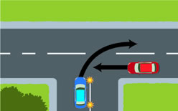
NE is a “natural law”
Go
Stop
-5,-5
1,0
Go
0,1
-1,-1
Stop
Notes:
NE is a unique probability distribution over the strategies. So, I say, some one who causes the accident, is because that guy is stupid, not wise.

Slide 28
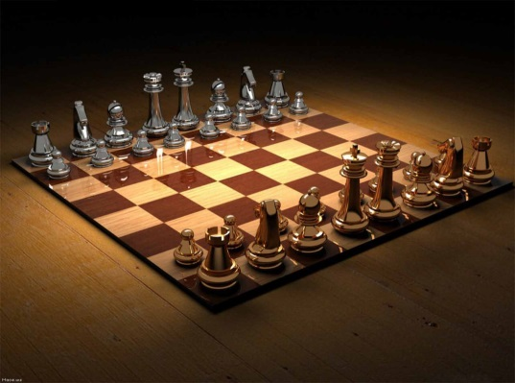
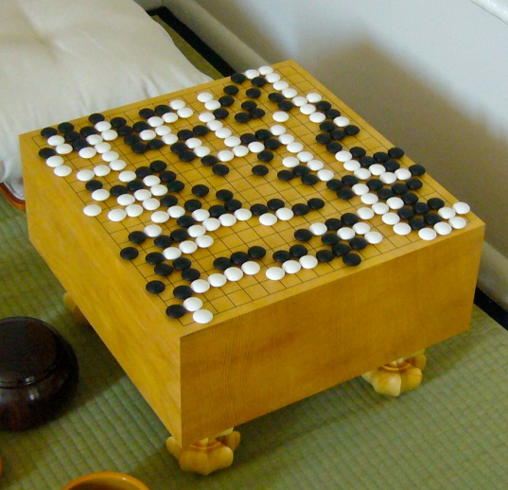
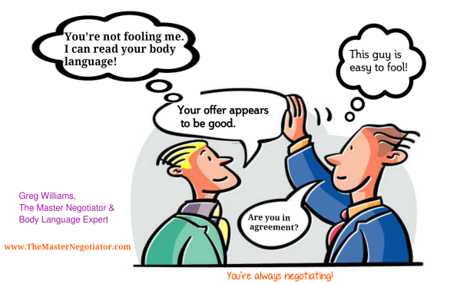
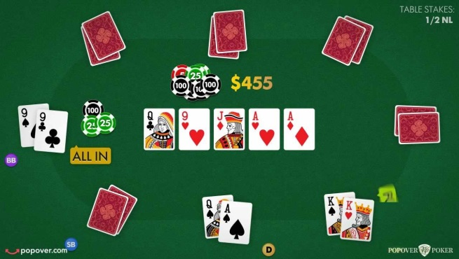
Games: Complete Information v.s. Incomplete Information
Games with
complete information
Chess
Go
Games with
incomplete information
Negotiation
Poker

Slide 29
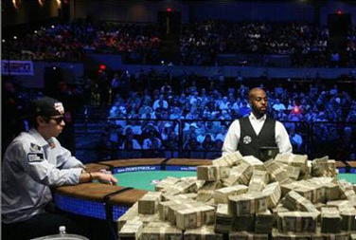
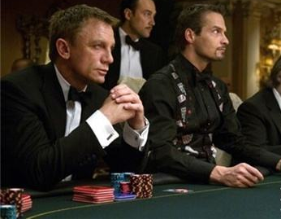

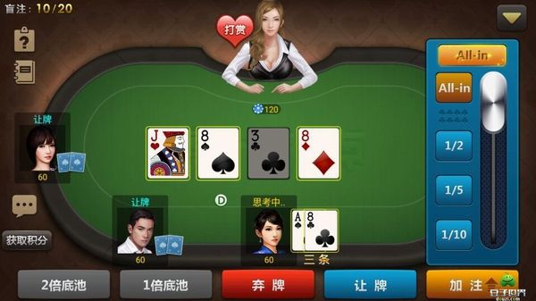
Texas Hold’em Poker
Preflop: two private cards are dealt to each player, followed by a betting round; players can either check, bet or fold
Flop: three public cards are dealt, followed by a betting round
Turn: a fourth public card is dealt, followed by a betting round
River: a last public card is dealt, followed by a betting round
The game ends when
Only one player is left, all the other players fold
A showdown; a hand with the best 5 cards using both the two private cards and the five public cards wins

Slide 30
Architecture of Libratus
Original game
Abstracted game
Abstraction
(offline)
action abstraction
card abstraction
took the game size from 10¹⁶¹ to 10¹²
Automated abstraction
Compute Nash
Reverse model
Nash equilibrium
Nash equilibrium
Equilibrium Finding
(offline)
CFR
CFR⁺
Monte Carlo CFR
Decomposition and Subgame Refinement
(online)
endgame solving
subgame re-solving
max-margin subgame refinement
Notes:
Counterfactual Regret(CFR) Minimization: very like the heuristic function used in previous lectures. A fast estimation of the future regrets.

Slide 31
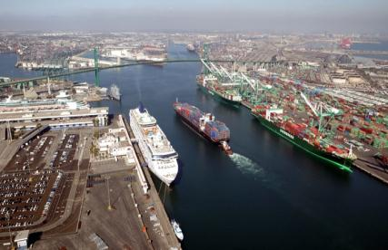
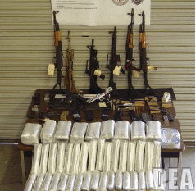

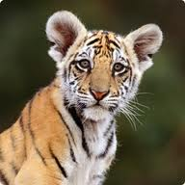
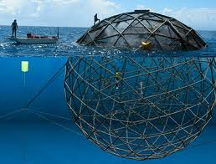

Global Challenges for Security
Key challenges: Limited resources, surveillance
Notes:
cannot guarantee 100% security must optimize

Slide 32


Stackelberg Games Randomization: Increase Cost and Uncertainty to Attackers
Security allocation
Target weights
Opponent reaction
Stackelberg: Security forces commit first
Optimal allocation: Weighted random
Strong Stackelberg Equilibrium
Attacker
 | Target #1 | Target #2
Target #1 | 4, -3 | -1, 1
Target #2 | -5, 5 | 2, -1
Defender
Notes:
Not looking for Nash equilibrium of simultaneous move game

Slide 33
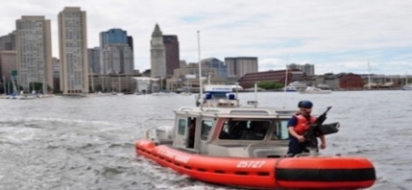
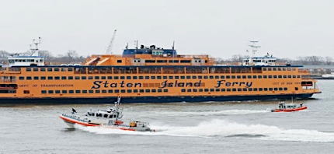
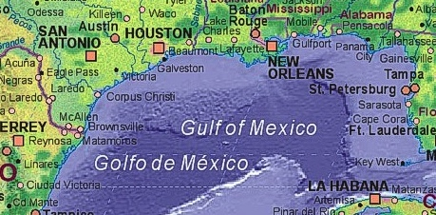


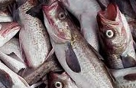
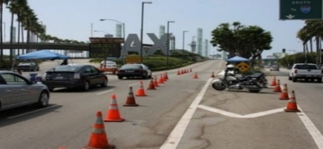

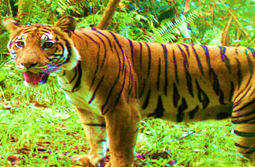
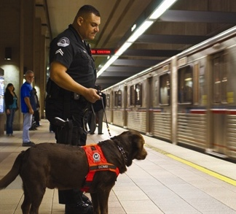

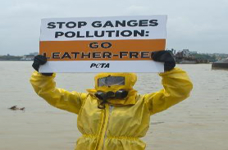
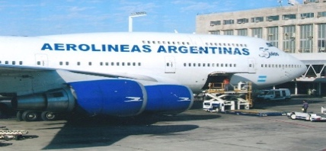
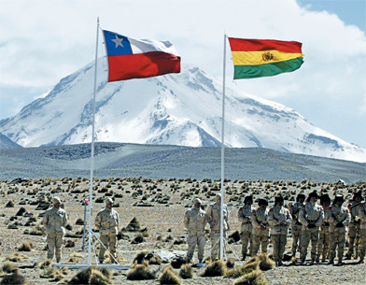
Game Theory for Security: Applications
Game Theory + Optimization + Uncertainty + Learning + …
Infrastructure Security Games
Green Security
Games
Opportunistic
Crime Games
Coast Guard
Coast Guard: Ferry
Coast Guard
LAX
TSA
Cyber Security
Games
LA Sheriff
Panthera/WWF
USC
Argentina Airport
Chile Border
India

Slide 34
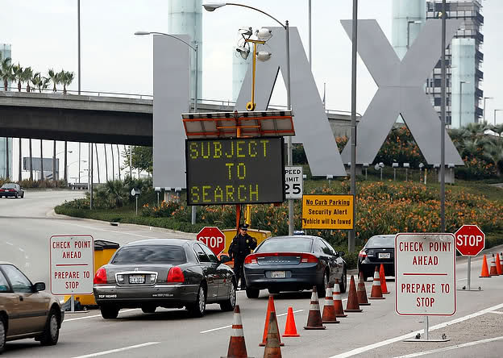
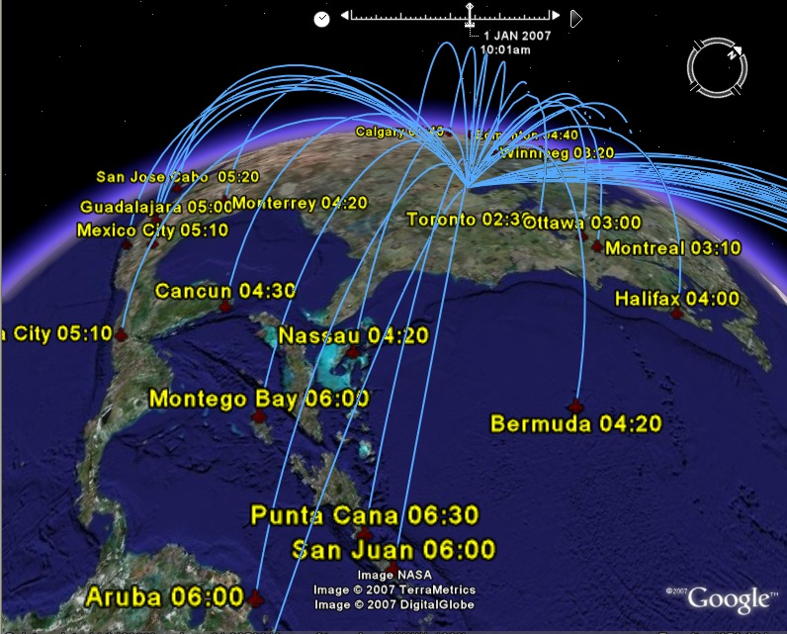
IRIS: Federal Air Marshals Service [2009] Scale Up Number of Defender Strategies
 | Strategy 1 | Strategy 2 | Strategy 3
Strategy 1
Strategy 2
Strategy 3
Strategy 4
Strategy 5
Strategy 6
 | Strategy 1 | Strategy 2 | Strategy 3
Strategy 1
Strategy 2
Strategy 3
Strategy 4
Strategy 5
Strategy 6
ARMOR
8 Terminals Actions: ~100
IRIS
1000 flights/day
Actions: ~10⁴¹
1000 Flights, 20 air marshals: 10⁴¹ combinations
ARMOR out of memory
Not enumerate all combinations combinations
Branch and price
Branch & bound + column generation

Slide 35

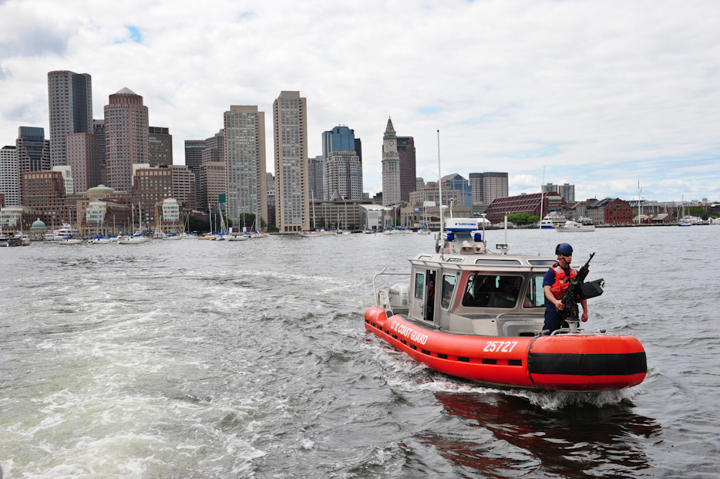
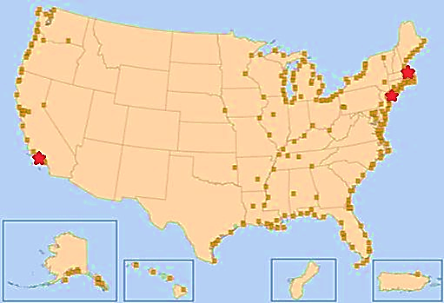
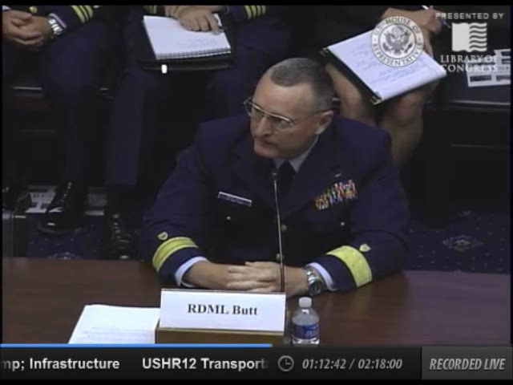


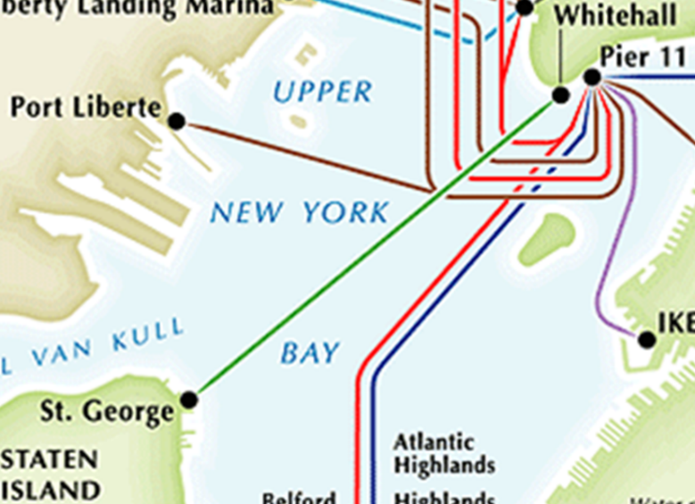
Coordination (Scale-up) and Ferries (Continuous Space/time)
PROTECT: Randomized Patrol Scheduling [2011]
t₂
t₃
t₇
t₄
t₁
t₆
t₅

Slide 36
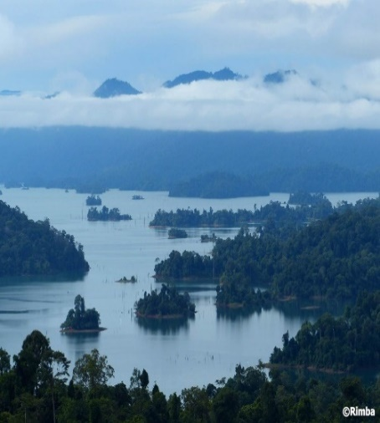
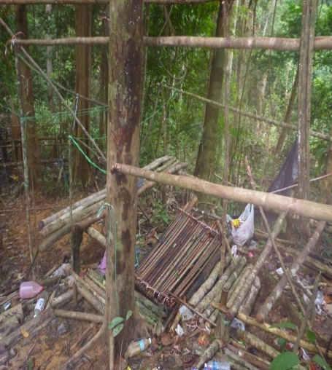
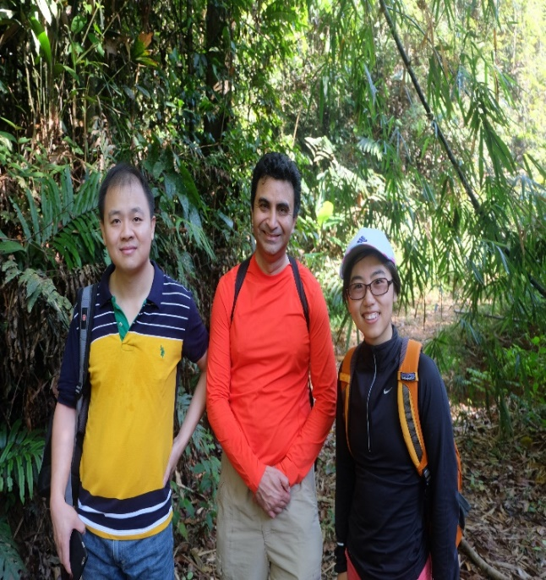
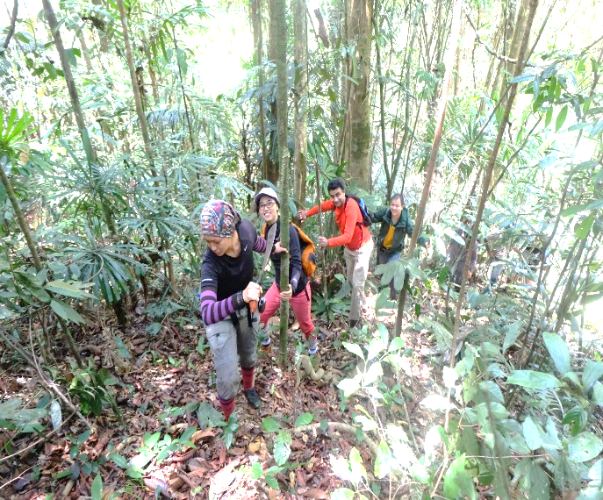
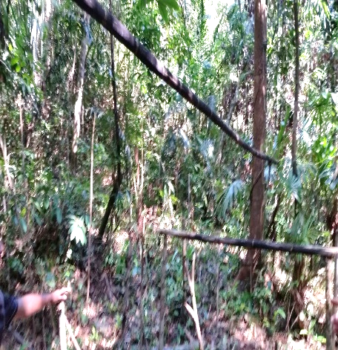
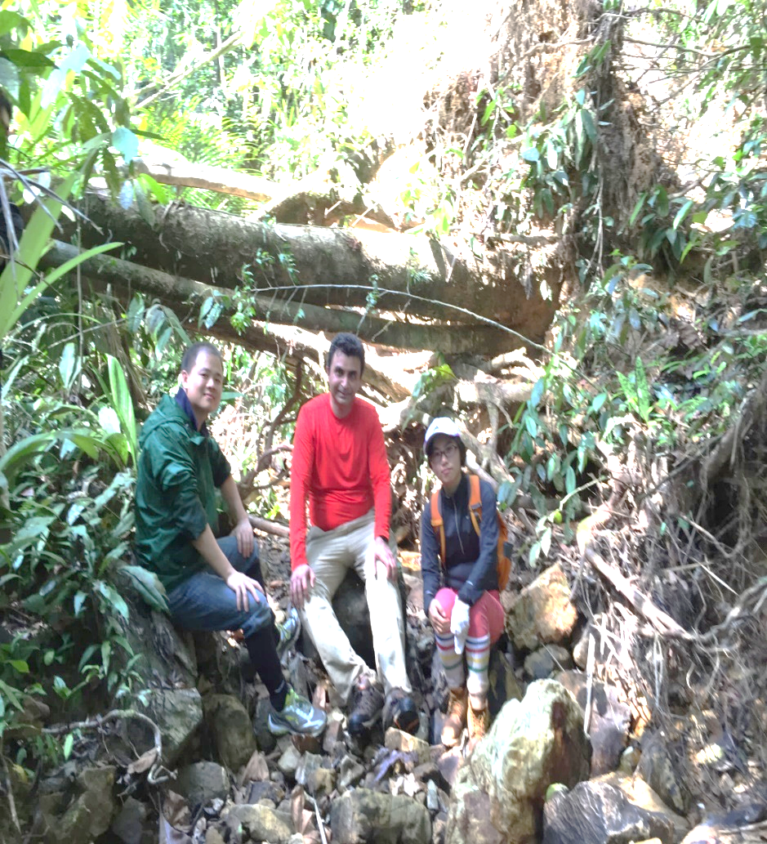
PAWS: Protection Assistant for Wildlife Security Trials in Uganda and Malaysia [2014]
Important lesson: Geography!
Uganda
Andrew Lemieux
Malaysia
Panthera
Malaysia

Slide 37







PAWS Deployed in 2015 in Southeast Asia (with Panthera and WWF)
PAWS Version 2: Features
Street map
Ridgelines, rivers/streams
Species Distribution Models (SDMs)
From data points to distribution map
Indonesia
Malaysia

